Slide 1
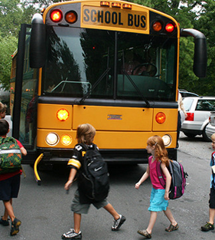
Does Student Transportation Matter to LAUSD Decisionmakers?
Sophia Balkovski & Sam Speroni
UP 229: Urban Data Science
May 4, 2022

Slide 2
Where are the school buses in California?
Distances and durations are roughly the same for all mode types
Source: National Household Travel Survey 2017

Slide 3
School Transport Policy in the U.S.
Varies widely state-to-state, district-to-district
Districts have the final say (and bill)
Four questions to ask:
Is school transportation mandated by the state?
Can school districts charge families for transportation?
What are the eligibility requirements?
What formula does the state use for reimbursement to districts?
Cost-based, per-capita, or mileage-based?
No
Yes
None
Same as 1982
Adapted from McDonald and Howlett, 2007

Slide 4
Research Questions
How frequently does the Los Angeles Unified School District (LAUSD) Board of Education discuss transportation-related issues?
What modes of travel do they discuss most?
How has all of this changed over the past 12 years?
Three shocks: 2011: State funding elimination proposal
2019: Free student transit cards proposal
2020: Pandemic

Slide 5
Next Steps
PDF parsing
Travel mode and temporal analysis
Possibly expand to other decisionmaking groups (e.g., Metro) or other large urban school districts with different policy environments

